Slide 1
-2016- COPS Hiring Program Grant
Police Staff Allocation Needs and Grant Acceptance Request

Slide 2
**Update Notice**
This PowerPoint has been updated from the original version that was presented to the Board of Selectmen and community members in September of 2016.
It now reflects updated information and exact statistics as opposed to forecasted estimates.
The annual local costs associated with the allocation of the 8th Officer position and subsequent tax burden are considerably less than originally estimated.

Slide 3
The Rindge Police Department Staffing…Now. (Updated on 2/1/17 from original presentation.)
Current funded staffing allocation = 8 full-time officers.
Chief
1 Sergeant
1 Detective
5 Patrol Officers
4 part-time officers are allocated. Two of these positions are currently vacant and we are presently recruiting.
After the original presentation of this PowerPoint to the Board of Selectmen and community members in September of 2016, an 8th officer position was approved so we could begin to correct our staffing shortages. The 8th officer was hired in January of 2017.

Slide 4
The direct effect…on our community.
Our current staffing allocation has improved with the addition of the 8th Officer position but we are still short-handed. It is directly impacting the quantity and quality of the services we can provide the community in many categories to include:
Proactive Patrolling
Traffic Enforcement
Criminal Investigations
Community Policing Activities

Slide 5
The direct effect…on our officers.
Officer Safety
Inadequate Supervision Due to Schedule
Reduced Investigative Ability
Increased Workloads for Officers
Increased Administrative Time/Decreased Patrol Time
Reduced Recruitment and Retention of Officers
Officer Physical and Mental Stress = Burnout

Slide 6
The Ultimate Effect
The safety of our community and our officers are at risk.

Slide 7
Understaffed…The Proof
To demonstrate the need for increased staffing, in addition to safety, efficiency, and effectiveness concerns, we also considered the following factors:
Staffing Allocation Comparisons
Calls for Service
MRI Report Recommendations
Vacant Shifts – Numbers and Costs

Slide 8
Comparisons to other communities
The agencies used in comparison to Rindge were chosen based on proximity, similar populations, and/or the presence of a college or university.
Jaffrey
Peterborough
Antrim
Henniker
Plymouth
New London

Slide 9
Comparisons to other communities (Updated on 2/1/17 from original presentation.)
 | Total Population* | College or University | College or University Resident Population | Full Time Sworn Officers
Rindge | 6014 | Franklin Pierce U | 1107 | 8
Jaffrey | 5403 | N/A | N/A | 11
Peterborough | 6450 | N/A | N/A | 12
Hooksett | 14499 | N/A | N/A | 29
Antrim | 2634 | N/A | N/A | 5
Henniker | 4883 | New England Col. | 623 | 12
Plymouth** | 6717 | Plymouth State U | 1977 | 13
New London | 4553 | Colby-Sawyer Col. | 1090 | 8
*Population estimates obtained from New Hampshire Office of Energy and Planning 2014 Census Report.
**Plymouth State University has its own Police Department in addition to Plymouth PD.

Slide 10
Officer to Population Ratios (Updated on 2/1/17 from original presentation.)
One method to estimate the number of police officers a community should have is to determine the officer to population ratio. Other factors such as the types and total number of calls for service, response time, and shift coverage should be considered.
A report from the International Association of Chiefs of Police (IACP) on the topic of officer to population ratios indicated that the communities with populations between 1000 – 9999 had an average officer to 1000 citizen ratio of approximately 2.40.
Per City-Data.com, as of 2014, the average officer to citizen ratio for all New Hampshire police departments is 2.19.
Rindge now has a population of approximately 6014, 8 full-time Officers, and a ratio of 1.33.

Slide 11
Officer to Population Ratios…a visual. (Updated on 2/1/17 from original presentation.)
*This is best case scenario. If a current officer is absent (Military Leave, Maternity Leave, Paternity Leave, etc. etc.) the ratio decreases.
Example - While Officer Griffin is on Military Leave our ratio drops to 1.16.

Slide 12
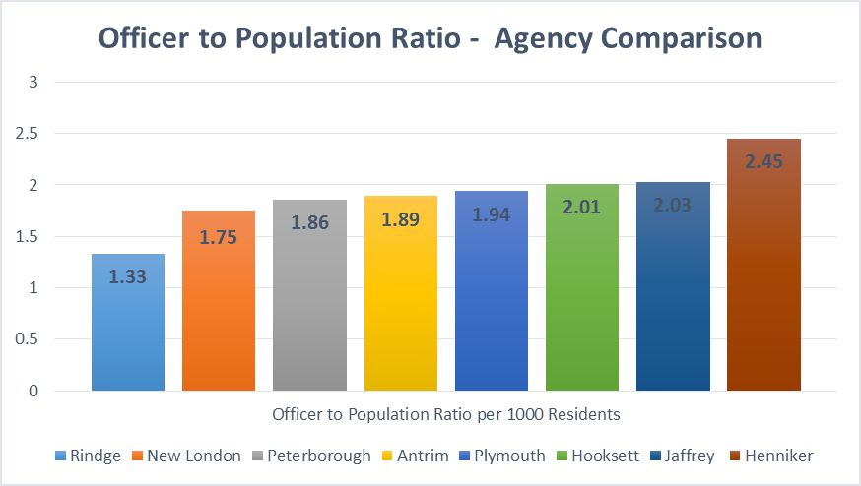
Ratios…Local Comparisons…a visual. (Updated on 2/1/17 from original presentation.)

Slide 13
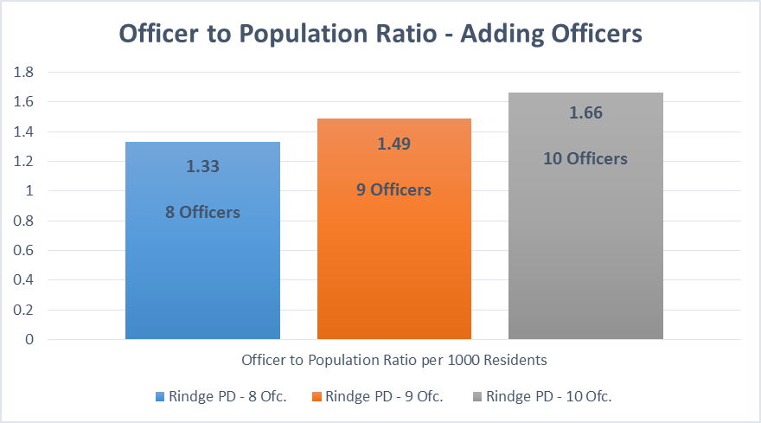
The effect of adding officers on ratios. (Updated on 2/1/17 from original presentation.)

Slide 14
Calls for Service have increased. (Updated on 2/1/17 from original presentation.)
Our calls for service numbers do not include traffic stops, residential checks, or business checks. Those are tallied separately.
Some other agencies combine their numbers and therefore, you can not always compare one town to another based on calls for service.
Jaffrey’s calls for service numbers are considerably higher than our for this reason.
We have experienced a 30.97% increase in calls for service since 2014.

Slide 15
The MRI Report
In October of 2014, Municipal Resources, Inc. (MRI) completed an assessment of the Rindge Police Department as part of their contract to provide Interim Police Management services while the Town undertook a Police Chief Recruitment and Selection Process.
The assessment and subsequent report included strong recommendations on how to correct deficiencies and improve operations.
The recommendations made in the report were reasonable and based on the present minimum needs of the department.

Slide 16
The MRI Report
The report recommendations were addressing the minimum needs of the department to emphasize…
Safety
Liability
Efficiency

Slide 17
MRI Report Recommendations
“Develop a schedule for the Sergeant that allows interaction with all officers, coverage and direct supervision on weekend nights, and allows for the completion of collateral duties and assessments.”
“Develop a schedule for the Detective that allows for consistency in the follow-up of major cases, time for evidence and property functions, and periodic interaction with all shifts.”
“Assess proper allocation levels.”

Slide 18
Staffing Allocation and Vacant Patrol Shifts
Based on our present staffing, our current shift schedule has one patrol officer working each day between the hours of 2:00AM and 9:00PM and two patrol officers working between the hours of 9:00PM to 2:00AM. One shift per week is vacant and is intended to be filled by part-time Officers.
Sergeant Anair is presently forced to fill a patrol shift on a full-time basis while maintaining all of his supervisory responsibilities.
Detective Seppala is frequently forced to fill patrol shifts as the need arises.

Slide 19
Staffing Allocation and Vacant Patrol Shifts (Updated on 2/1/17 from original presentation.)
3 shifts per day x 365 days per year = 1095 Patrol Shifts per year
1 Patrol Officer = 190 Shifts per year*
5 Patrol Officers x 190 = 950 Patrol Shifts per year
1095-950 = 145 vacant Patrol Shifts per year**
*Individual Patrol Officer shifts per year factor in vacation, sick time, and mandatory training.
**This is the best case scenario following the MRI recommendations. This assumes all allocated patrol officers are present and able to work. (No one is on Military Leave, Maternity Leave, Paternity Leave, etc. etc.)

Slide 20
Costs to fill vacant shifts…current allocation. (Updated on 2/1/17 from original presentation.)
Cost to fill 145 vacant shifts =
(Part-time rate “PT”= $20.97/hr)
(Full-time Officer Average Overtime Rate “FT”= $34.60/hr)
Utilizing…
100% PT = $30,392
(Presently impossible)
50% FT/50% PT = $40,281
(Very unlikely scenario)
66% FT/33% PT = $43,547
(Most realistic scenario)

Slide 21
Costs to fill vacant shifts…adding a 9th Patrol Officer in the future. (Updated on 2/1/17 from original presentation.)
Cost = $0
Adding a 9th Patrol Officer in the future closes the open shift gap and provides us a 45 shift cushion.
The extra 45 shifts could be utilized to:
Fill unanticipated absences
Special Investigations (drugs etc.)
Directed Activity Patrols
Community Policing Activities
Training

Slide 22
The 2016 COPS Hiring Program Grant…What is it?
The 2016 COPS Hiring Program (CHP) is a program through the US Department of Justice.
It is designed to advance public safety through community policing by addressing the full-time sworn officer needs of local law enforcement agencies nationwide.
The CHP provides funds directly to law enforcement agencies to hire new and/or rehire career law enforcement officers and to increase their community policing capacity and crime prevention efforts.

Slide 23
The 2016 COPS Hiring Program Grant…What is it?
The grant is a four year commitment that will provide the Town of Rindge a total of $125,000, over the first three years, to cover the cost of the entry-level salary and benefits of one new police officer position.
The Town of Rindge is required to pay the full cost of the salary and benefits the entire fourth year.
After the fourth year, the Town of Rindge can choose to keep or eliminate the position.

Slide 24
Success and a huge opportunity!
1,181 agencies nationwide competed for a COPS Grant in 2016.
Only 181 agencies were awarded grants. (15.3% of all applicants.)
Only 4 agencies in New Hampshire received awards.
Rindge PD had the highest score of all NH applicants.
Rindge is one of only 2 agencies nationwide to be awarded a grant in the community “Quality of Life” category.
We must vote to accept the grant at the Town Meeting in March in order to receive the federal funding.

Slide 25
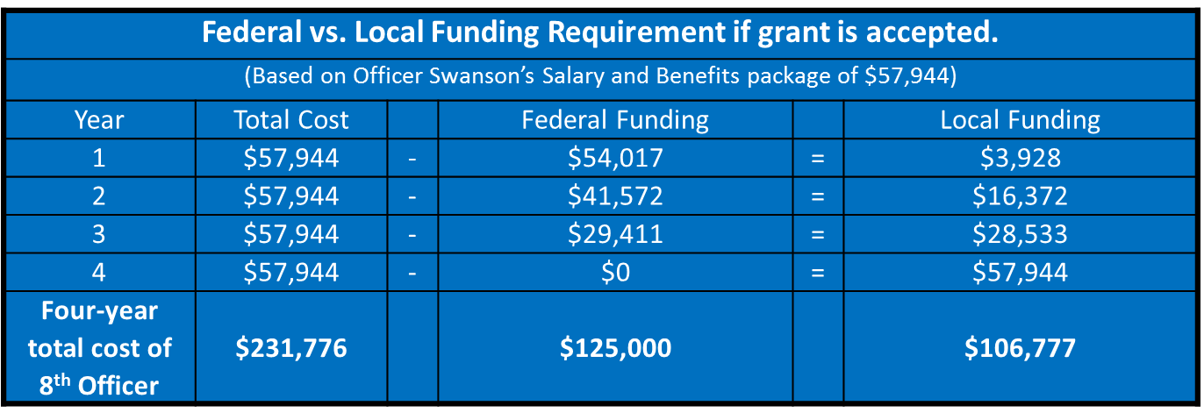
The cost…federal vs. local funding requirement. (Updated on 2/1/17 from original presentation.)
The grant funds would be distributed over three years in a manner that gradually raises the local funding requirement up to the full cost of an entry level officer with benefits.
Officer Swanson was hired to fill the 8th position. Her total cost with benefits for one year is $57,944*. *Local funding may increase if future raises are given or Officer Swanson’s health benefits category changes.

Slide 26
Tax impact of the 8th Officer…with/without grant (Updated on 2/1/17 from original presentation.)
Potential Tax Impact of the 8th Officer Position*
(Based on a $200,000 property.)
Year | Annual cost without grant | Annual cost with grant | Monthly cost without grant | Monthly cost with grant
1 | $22.10 | $1.50 | $1.84 | 12.5 cents
2 | $22.10 | $6.24 | $1.84 | 52 cents
3 | $22.10 | $10.88 | $1.84 | 91 cents
4 | $22.10 | $22.10 | $1.84 | $1.84
Four-year total = | $88.40 | $40.72
*Costs may increase after year 1 if future raises are given or Officer Swanson’s health benefits category changes.

Slide 27
Who supported our effort to secure this grant?
Letters of Support Submitted by:
New Hampshire Governor Maggie Hassan
United States Senator Kelly Ayotte
New Hampshire Senator Kevin Avard
New Hampshire Representative John Hunt
New Hampshire Representative Susan Emerson
Franklin Pierce University President Andrew Card

Slide 28
Who supported our effort to secure this grant?
Jaffrey-Rindge Cooperative School District
Rindge Chamber of Commerce
Rindge Crime Watch
Jaffrey-Rindge Rotary Club
The First Congregational Church of Rindge
Walmart
Hannaford Supermarket
Market Basket Supermarket
GFA Federal Credit Union
TD Bank

Slide 29
Conclusion
Our staffing is improving but the safety of our community and our officers are still at risk.
We should strongly consider hiring a 9th Officer in the future to close the vacant shift gap, enhance safety, and improve services.
The COPS Hiring Grant is the most effective way to offset the costs associated with the salary and benefits of the 8th Officer.
We can recapture $125,000 of our tax money in the process. If we don’t take it, another community will.

Slide 30
Message from the Chief
Thank you for taking the time to view this presentation. It is critical that our citizens have accurate information on which to base their decisions. If you have any questions, comments, or concerns please contact me. I can share facts, statistics, and perspectives in hopes of fostering mutual respect, trust, and understanding. Please feel free call me, email me, or stop by the station for a visit.
Very Respectfully,
Todd A. Muilenberg
Chief of Police
Chief Todd Muilenberg
Contact Information:
603-899-5009
tmuilenberg@police.rindge.nh.us
158 Main Street
Rindge, NH, 03461

Slide 31
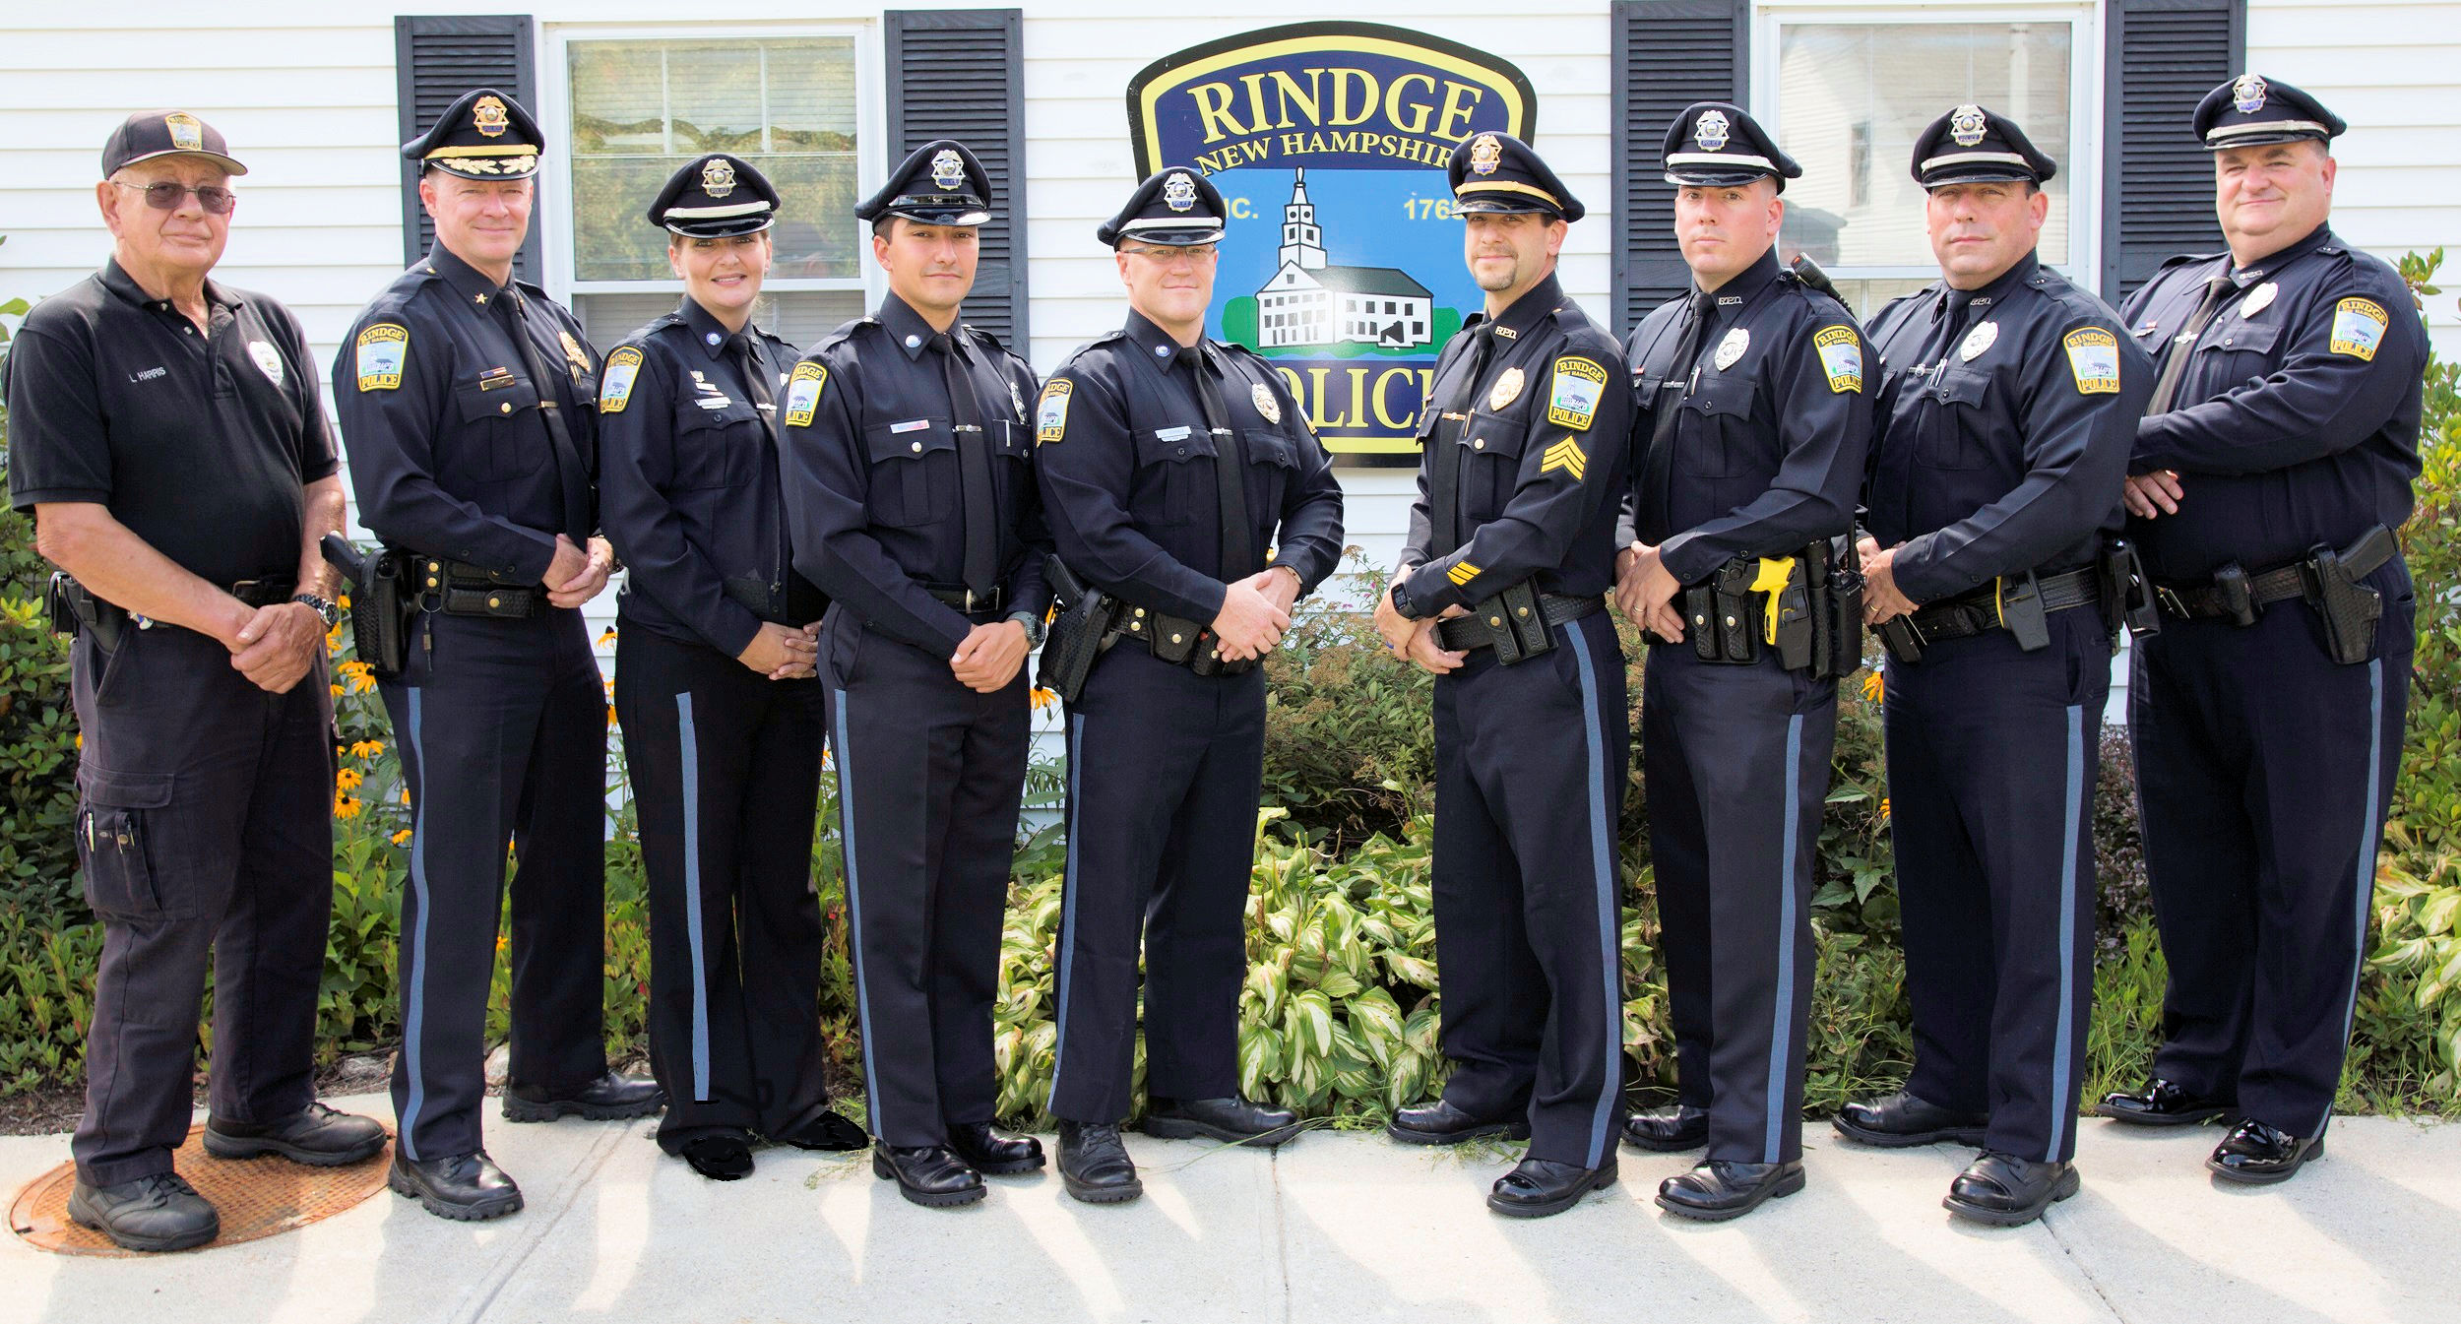
Please help us help you.

